Slide 1
 |  | multicate | CausalMetaR | metacart | personalized
Overview |  | Estimates the CATE across multiple studies using machine learning techniques and predicts the CATE in a target population of interest | Provides robust and efficient methods for Causally Interpretable Meta-Analysis – estimating causal effects in a target population using a multi-source dataset | Integrates classification and regression trees (CART) into meta-analysis to identify interaction effects between moderators | Provides functions for fitting and validation of models for subgroup identification and personalized medicine / precision medicine
Key Features | Handles multiple Studies/sources | ✅ | ✅ | ✅
 | Provides multiple aggregation methods | ✅
 | Includes multiple estimation methods | ✅ | ✅ | ✅ | ✅
 | Identifies heterogeneity across multiple studies | ✅ | ✅ | ✅
 | Supports Individual patient-level data (IPD) | ✅ | ✅ |  | ✅
 | Estimates CATEs across multiple studies | ✅ |  |  | ✅
 | Predicts CATEs in a target population | ✅ |  |  | ✅
To include: something about machine learning methods? More about the visuals/interpretability?

Slide 2
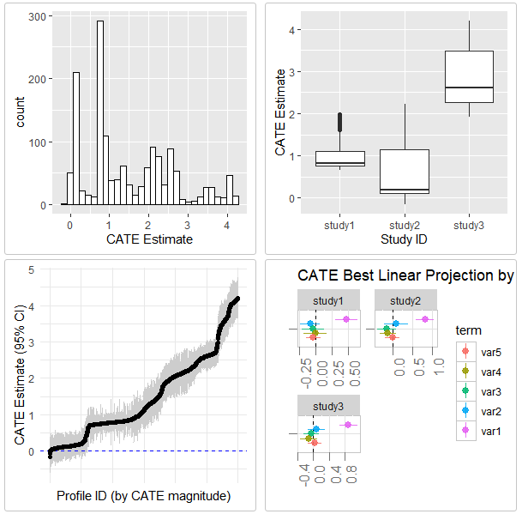
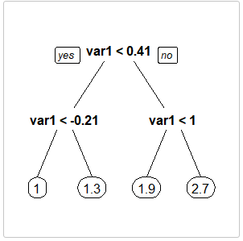
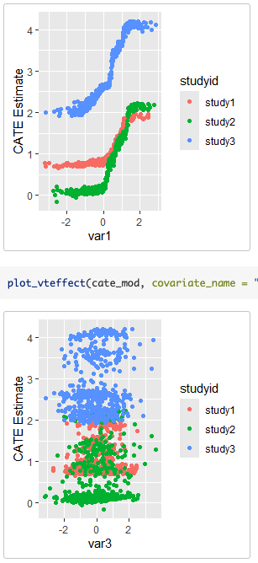
A. Histogram of Estiamted CATEs
B. Boxplot of CATEs by Study ID
C. 95% CI Plot for All CATEs
D. Interpretation Tree
E. Best Linear Projection
F. Covariate-CATE by Study ID

Slide 3
Trial 1
Trial 2
Trial K
Target group
Training data
Multiple studies comparing treatment efficacy
Step 1
Estimate CATE using estimate_cate() and store the model
Target population
Group of patients at baseline in a health care system
Step 2
Apply the model to target population using predict()

Slide 4
Aggregation Methods
Pooling with Trial Indicator [Brantner et al., 2024]: Pool all data together but keep study as an indicator and include that as a covariate in the single-study approaches
Trial 1
Fit single-study method
Pooled data with trial membership
Trial 2
…
Trial K

Slide 5
Aggregation Methods
Ensemble Forest [Tan et al., 2023]: Fit model within each study, apply each model to all individuals, and then fit an ensemble random forest to the augmented data
Trial 1
Fit ensemble model
Augmented data with K predictions per person
Trial 2
Predict according to trial 1, trial 2, …, trial K models
Fit single-study method
…
Trial K

Slide 6
Before updates

Slide 7
Training data
Multiple studies comparing treatment efficacy
Target population
Group of patients at baseline in a health care system
Data
Step 1
Estimate CATE in studies
Step 2
Predict CATE in target population
Approach

Slide 8
 | multicate | CausalMetaR | metacart | personalized
Overview | Estimates the CATE across multiple studies using machine learning techniques and predicts the CATE in a target population of interest | Provides robust and efficient methods for Causally Interpretable Meta-Analysis – estimating causal effects in a target population using a multi-source dataset | Integrates classification and regression trees (CART) into meta-analysis to identify interaction effects between moderators | Provides functions for fitting and validation of models for subgroup identification and personalized medicine / precision medicine
Specifically for Clinical data? | ✅ | ✅
Multiple Studies/sources? | ✅ | ✅ | ✅
Heterogeneity? | ✅ | ✅ | ✅ | ✅
Individual data (IPD)? | ✅ | ✅ | ✅
Estimation of CATE? | ✅ |  | ✅
Prediction of CATE? | ✅ |  | ✅ | ✅
To include: something about machine learning methods? More about the visuals/interpretability?

Slide 9
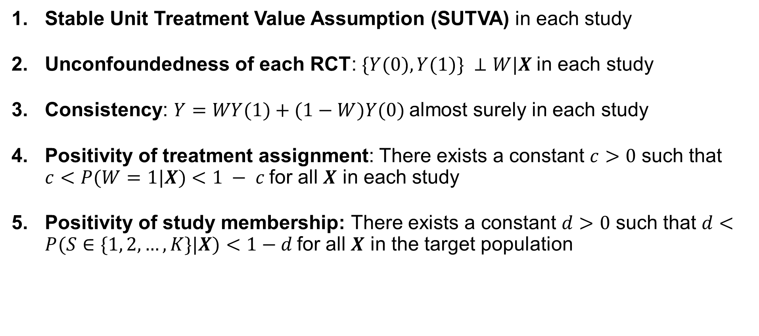
Assumptions
Stable Unit Treatment Value Assumption (SUTVA) in each study
Unconfoundedness of each RCT: $\{Y(0), Y(1)\} ⊥W|X$in each study
Consistency: $Y=WY(1)+(1−W)Y(0)$almost surely in each study
Positivity of treatment assignment: There exists a constant $c>0$ such that $c<P(W=1|X)<1 − c$for all $X$ in each study
Positivity of study membership: There exists a constant $d>0$ such that $d<P(S∈\{1, 2, …, K\}|X)<1−d$for all $X$ in the target population

Slide 10
Single-study methods
S-Learner
Causal Forest
Aggregation methods
No Pooling
Pooling with Trial Indicator
Ensemble Forest

